Slide 1

How to Use Generative AI for Protecting Sensitive Data and Improve Operations
By: Jasmine Roberts

Slide 2
Table Of Content
Introduction to Generative AI
Problem Statement
Research Questions
Broader Impacts/Would would happen if we didn't have improvements?
Purpose of the Research
Case Study: Mailchimp Breach
Method 1 Article 1: Data Encryption and Decryption techniques for a High Secure Dataset using AI
Method 2 Article 2: Data Auditing Building Trust in Artificial Intelligence
Method 3 Article 3: Data Anonymization Evaluation for Big Data and IoT Environments
Method 4 Article 4: AI and ML to Enhance Data Backup and Recovery
Method 1: Boxcryptor
Method 2: Oracle Audit Vault and Database Firewall
Method 3: ARX
Method 4: Urbackup
Summary
References

Slide 3

Introduction to Generative AI
In today’s advancing world, generative AI is becoming the way of life
Generative AI is a helpful tool for solving solutions and protecting data management
Generative AI is another way of thinking about automation as far as its responses
It supplies responses without exposing sensitive information, this is a way of maintaining privacy
If you are using Generative AI for protecting sensitive data, the data remains encrypted and will never be decrypted
Inside of this project we would provide many methods on How to use Generative AI for Protecting Sensitive Data and Improve Operations

Slide 4
Problem Statement
The core of the problem is to do a deeper dive in how Generative AI can be effective for protecting sensitive data and improving operations.
What would happen if we didn't have any security supplied by Generative AI ?

Slide 5

Research Questions
What are the benefits of using AI?
How can AI be considered a better resource more than human efficiency?
How can AI be more efficient with improving operations?
How can AI be more efficient with supplying better security?

Slide 6

Broader Impacts/Would would happen if we didn't have improvements?
Simply, if we didn't have these 6 benefits, AI’s impact on society would be huge. It would be rough on security and improving operations, because it would be tough on trying to navigate a resolution on security and improvement.
Optimize Processes
Can consist of using machine learning to understand optimal settings for many networks
Makes decisions on base data
Impacts by making decisions on base data, by making these decisions efficient, and faster.
It is able to provide many amounts of data within minutes.
3. Improve Productivity
By completing tasks on your network/ operations
4. Improve Efficiency
Can automate, and is quick with catching errors within your material

Slide 7

Broader Impacts/What would happen if we didn't have improvements?
5. Improve Operations
Enhances by automation, and speed
Provides data within seconds
Can maintain data
6. Better Security Data
Can be used as an analyzer
Uses its machine learning to detect issues that have malicious intent
Can encrypt your data for protection

Slide 8
Purpose of the Research
Purpose:
To explore the diverse benefits of Generative AI, developed by OpenAI, and its impact on enhancing organizational operations.
Focus Areas:
Analysis of how Generative AI optimizes processes, facilitates data-driven decision-making, and improves productivity and efficiency.
Operational Efficiency:
Examination of Generative AI’s role in streamlining workflows, automating routine tasks, and boosting overall operational effectiveness.
Security Enhancement:
Assessment of how Generative AI strengthens security measures, including data protection and cybersecurity protocols.
Digital Agility:
Evaluation of how Generative AI can improve organizational digital structures, making operations more agile and responsive to changing demands.

Slide 9

Case Study: Mailchimp Breach
Second Breach
Mailchimp was hacked again, exposing data from 133 accounts, including WooCommerce, through a social engineering attack.
Repeat Incident:
The breach mirrors one in August 2022, raising doubts about the company's security measures.
Leadership Gap:
Mailchimp’s CISO left after the August breach, leaving questions about its cybersecurity oversight.

Slide 10
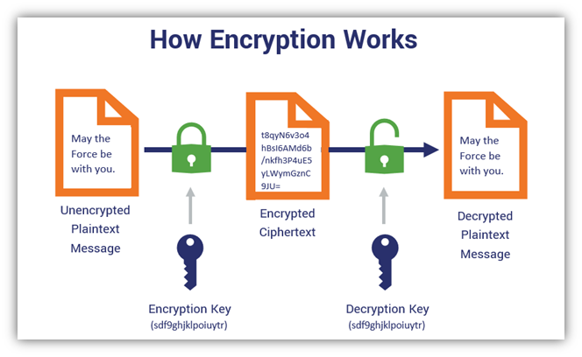
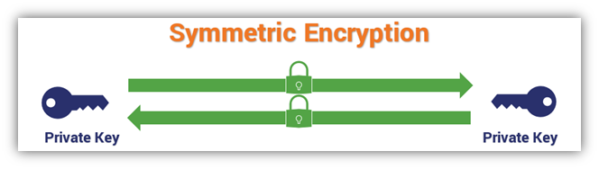
Method 1 Article 1: Data Encryption and Decryption techniques for a High Secure Dataset using AI (3)
Is a method to use when trying to secure data and improve operations
The way to turn your data into encrypted data is to make it intelligible by public keys and cipher text
Your data would be very hard to understand and read
Uses Symmetric Key
Uses Cipher Text
It requires machine learning
An algorithm that can recognize when the data is unsafe to be used

Slide 11

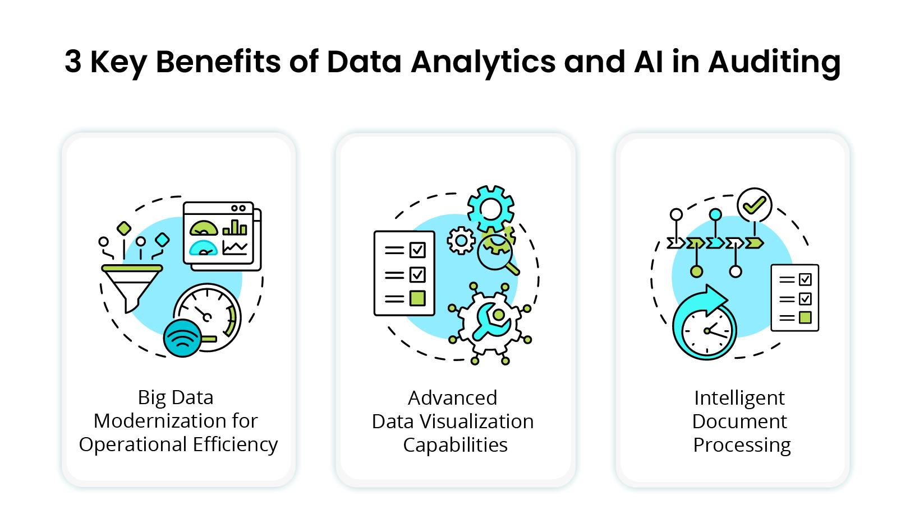
Method 2 Article 2: Data Auditing Building Trust in Artificial Intelligence (7)
Is a method to secure data
Improves operations using Artificial Intelligence
Can build data discipline
Can help improve the stability
Can improve itself
Can help close gaps
Can help maintain and improve the stability of operations

Slide 12
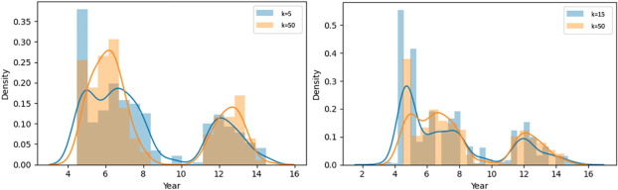
Method 3 Article 3: Data Anonymization Evaluation for Big Data and IoT Environments(6)
Is used to prevent shares from being re-identified as private or sensitive information
Can turn your data into an algorithm
Can improve the AI performance to take your privacy concerns under consideration
Can build and refine your data into something secure
Enables compliance with operations by having a diverse dataset and an improved performance
Reduces the risk of any malicious intent
The encryption and the data itself cannot be reversed
It can erase sensitive data

Slide 13
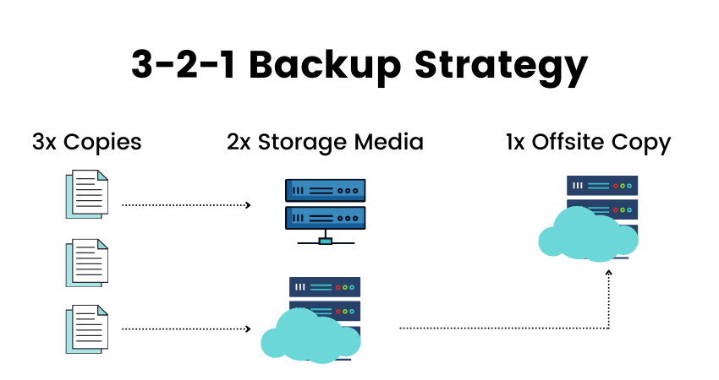

Method 4 Article 4: AI and ML to Enhance Data Backup and Recovery (8)
Is a solution to where you are analyzing many amounts of data and
Can identify patterns to enable threat detection, and response
Provides your data with the less impact of human errors if you use AI
Can handle the routine tasks for the backup process
Ensures that you will have something to come back from if something bad happens to your data
Consists of continuous learning and improvement

Slide 14
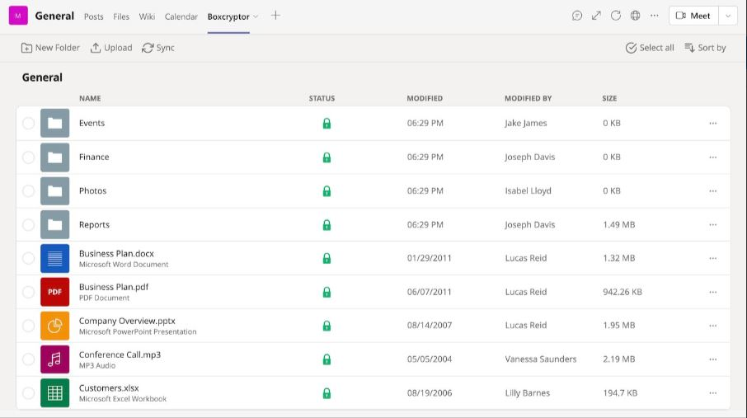
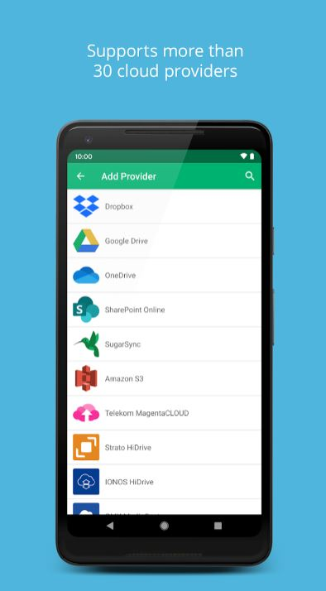
Method 1: Boxcryptor
Boxcryptor:
encrypts files using AES-256 and RSA-4096 before syncing them with Microsoft Teams and the cloud.
Encryption:
happens client-side, ensuring only authorized users can access the data.
Files are encrypted:
in the background during uploads without disrupting your workflow.
The app:
can access limited personal information but cannot read or modify other mailbox content.
Boxcryptor General window on the PC.
Boxcryptor Cloud provider Adding window on phone.

Slide 15
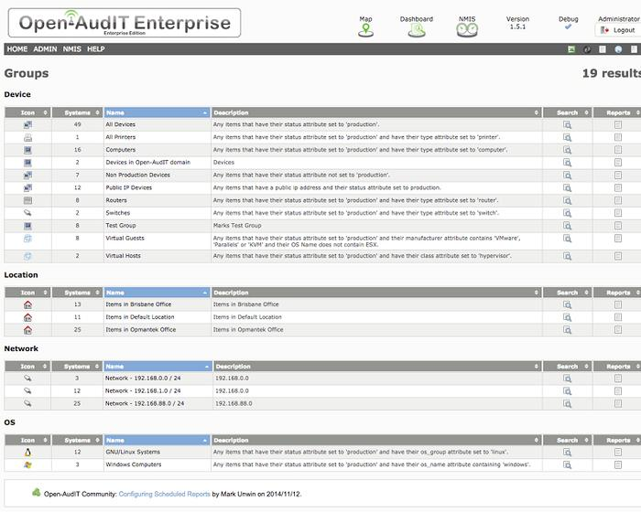
Method 2: Open-AudIT
Network Audit:
Open-Audit provides real-time data on assets, showing what's in the network, how it's configured, and tracking changes.
Automated Reporting:
It automates device discovery and reporting, with easy-to-read dashboards and charts.
Efficiency & Compliance:
Helps IT professionals reduce overhead by automating tasks and ensuring inventory management and compliance.
Access Control & Flexibility:
Supports role-based access, integrates with Active Directory, and offers detailed device logs for advanced users.
Results of Open-AudIT

Slide 16
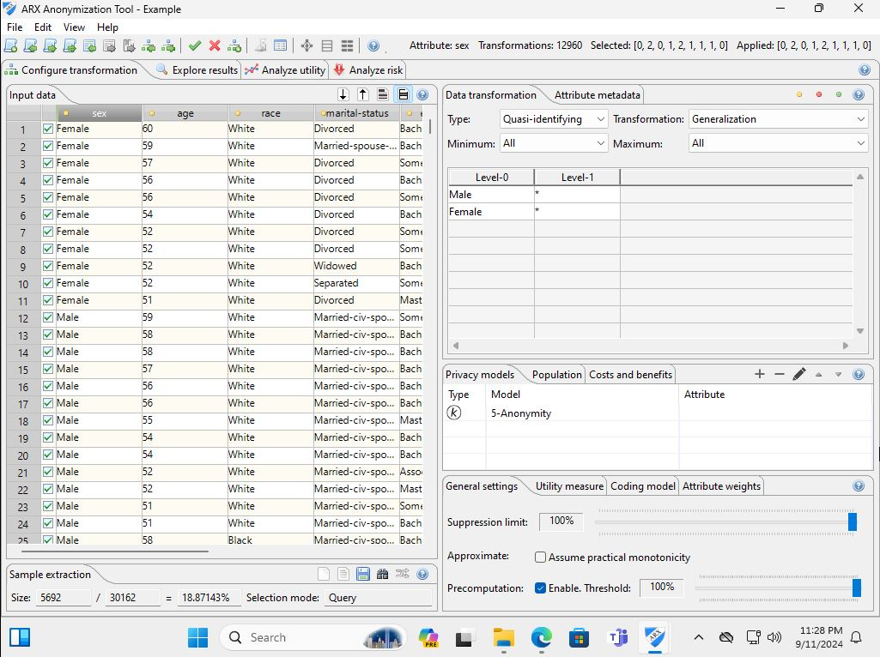
Method 3: ARX
ARX Overview:
Open-source tool for anonymizing personal data and ensuring privacy compliance.
Privacy Models:
Supports k-anonymity, l-diversity, t-closeness, and differential privacy.
Transformation:
Offers generalization, suppression, microaggregation, and coding techniques.
Features:
Includes data transformation rules, utility analysis, risk estimation, and semi-automated adjustments.
Results of the ARX window with a project running

Slide 17
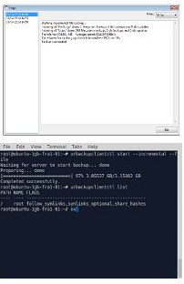
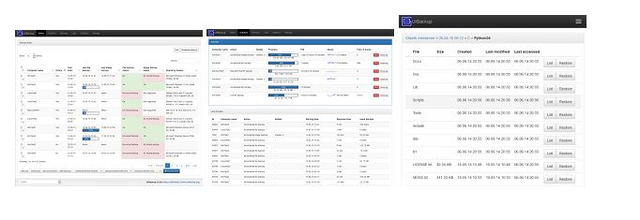
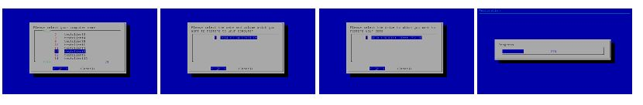
Method 4: Urbackup
Results of the Urbackup window with Client screenshots.
UrBackup Overview:
Open-source solution for file and image backups with minimal disruption.
Incremental Backups:
Continuously backs up only modified files for efficiency.
Flexible Restoration:
Restores files via web interface, client app, or Windows Explorer; supports full system recovery with a bootable USB.
Popularity:
Used in over 21,000 server instances, proving its reliability for personal and enterprise use.
Results of the Urbackup Server web interface screenshots.
Results of the Urbackup Restore screenshots

Slide 18
Summary
Generative AI in Cybersecurity: Essential for enhancing data protection with advanced automation, maintaining encryption, and using machine learning to detect and analyze threats, vulnerabilities, and attacks.
Research Focus: Investigates how generative AI improves data protection and organizational efficiency through methods like virtual network testing, script development, and technology reviews.
Applications of Generative AI:
Threat Intelligence: Analyzes data from multiple sources.
Phishing Simulations: Enhances email security.
Vulnerability Management: Suggests and tests patches.
Incident Response: Automates response processes.
Employee Training: Improves cyber threat awareness.
Software and Tools:
Boxcryptor: is a files client-side, seamlessly securing data during uploads to Microsoft Teams and the cloud
Open-AudIT: Open-Audit offers real-time asset data, revealing network inventory, configurations, and tracking changes.
ARX: Open-source data anonymization tool with various privacy models.
UrBackup: Provides efficient file and image backups with incremental and flexible recovery.
Conclusion: Generative AI significantly enhances cybersecurity, data protection, and operational efficiency, offering advanced capabilities to address evolving cyber threats.

Slide 19
References 1/2
(1) Crane, C. (2020, November 4). Symmetric Encryption 101: Definition, How It Works & When It's Used. The SSL Store. Retrieved September 11, 2024, from https://www.thesslstore.com/blog/symmetric-encryption-101-definition-how-it-works-when-its-used/
(2)Generative AI in Network Performance Optimization. (2024, July 11). Matellio. Retrieved September 10, 2024, from https://www.matellio.com/blog/generative-ai-in-network-performance-optimization/
(3)Hayadi, B.H. .., & Haryanto, E. V. (2020, September 1). Data Encryption and Decrption Techniques for a High Secure Dataser Using AI. Melange Publications. Retrieved September 11, 2024, from http://iirjet.org/index.php/home/article/view/35/10
(4)How To Use AI in Decision Making. (n.d.). Upwork. Retrieved September 10, 2024, from https://www.upwork.com/resources/ai-in-decision-making
(5)Maximize Your Data Protection With The 3-2-1 Backup Rule | StoneFly. (n.d.). StoneFly Inc. Retrieved September 11, 2024, from https://stonefly.com/blog/maximize-data-protection-3-2-1-rule/
(6)Ni, C., Cang, L. S., Grape, P., & Min, G. (n.d.). Data anonymization evaluation for big data and IoT environment. Science Direct. Retrieved September 11, 2024, from https://www.sciencedirect.com/science/article/abs/pii/S0020025522004662
(7)Pearce, G. (2019, November 1). Data Auditing: Building Trust in Artificial Intelligence. ISACA. Retrieved September 11, 2024, from https://www.isaca.org/resources/isaca-journal/issues/2019/volume-6/data-auditing-building-trust-in-artificial-intelligence
(8)Russel, D. (2024, July 5). AI and ML to Enhance Data Backup and Recovery. VEEAM. Retrieved September 11, 2024, from https://www.veeam.com/blog/ai-ml-enhanced-backup-recovery.html
(9)Subramaniam, A. (2023, November 6). How AI-powered Data Analytics Can Redefine Audit Processes: An Intelligent Operating Model. KANINI. Retrieved September 11, 2024, from https://kanini.com/blog/how-ai-powered-data-analytics-redefines-audit-processes-an-intelligent-operating-model/

Slide 20
References 2/2
(10)(N.d.). Retrieved from https://arx.deidentifier.org/
(11)Client/server open source network backup for windows and linux. (n.d.). Retrieved from https://www.urbackup.org/index.html
(12)Community growth. (n.d.). Retrieved from https://www.openfhe.org/
(13)Homomorphic encryption. (2024). Retrieved from https://en.wikipedia.org/wiki/Homomorphic_encryption#:~:text=7%20External%20links-,Description,extension%20of%20public%2Dkey%20cryptography.
(14)Whittaker, Z. (2023). Mailchimp says it was hacked - again. Retrieved from https://techcrunch.com/2023/01/18/mailchimp-hacked/
(15)(N.d.). Retrieved from https://appsource.microsoft.com/en-us/product/office/wa200003781?tab=overview
(16)Boxcryptor - apps on Google Play. (n.d.). Retrieved from https://play.google.com/store/apps/details?id=com.boxcryptor2.android&hl=en_US
(17)The best 7 free and open source audit software solutions. (2024). Retrieved from https://www.goodfirms.co/audit-software/blog/best-free-open-source-audit-software-solutions
(18)Unwin, M. (n.d.). Audit - the network inventory, audit, documentation and Management Tool. Retrieved from https://www.open-audit.org/

Slide 21
THE END

